Slide 1



Sai vikram .K
Project title:
Sales analytics dashboard

Slide 2



PROBLEM STATEMENT
"Our company needs a comprehensive sales data dashboard to gain actionable insights and make informed business decisions. The dashboard should provide a real-time overview of our sales performance and key metrics, allowing us to track and analyze sales data efficiently. We are looking for a solution that can integrate data from various sources, visualize it in a user-friendly manner, and enable us to identify trends, opportunities, and potential areas for improvement in our sales operations. The dashboard should cater to the needs of different stakeholders, including sales managers, marketing teams, and executives, by presenting relevant information and facilitating data-driven decision-making. Additionally, it should be scalable and adaptable to accommodate future data sources and evolving business requirements."

Slide 3



Main objective of the project
The main objective of this project is to create a dashboard for
Sales and profit analyses: Monitor and display real-time and historical sales revenue to assess performance against targets and benchmarks.
Geographic Analysis: Visualize sales data geographically to identify regions with growth potential or underperformance, helping with localized marketing efforts and expansion plans.
Sales Pipeline Management: Provide visibility into the sales pipeline, including the number of leads, opportunities, and deals at each stage, to track progress and identify potential bottlenecks.
Profitability Analysis: Calculate and visualize the profitability of products, customers, or regions to make data-driven decisions on resource allocation and pricing strategies.

Slide 4



Approach
Data Collection and Integration:
Collect data from various sources, including CRM systems, sales transactions, marketing campaigns, and external market data.
Integrate data from disparate sources into a unified data warehouse or analytics platform to ensure consistency and accessibility.
Data Cleaning and Preprocessing:
Cleanse and preprocess the data to remove duplicates, handle missing values, and ensure data accuracy.
Standardize data formats and resolve inconsistencies in naming conventions.
Geospatial Analysis:
Analyze sales data by geographic location to identify regional variations and opportunities for expansion or targeted marketing efforts.

Slide 5
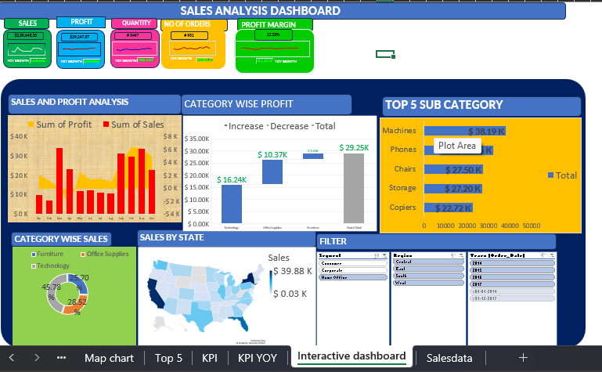
DASHBOARD VISUALS

Slide 6



CONCLUSION: In conclusion, sales data analytics is a powerful tool that empowers organizations to make informed decisions, optimize processes, and drive revenue growth. By collecting, cleaning, and analyzing sales data through various approaches, businesses can gain valuable insights into their sales performance, customer behavior, and market trends
DATASET LINK:
THANK YOU

